Slide 1
Respiratory diseases part II
Dr KWIZERA NDEKEZI Jackson
Anesthesiologist

Slide 2
1. Pneumonia
Dr Jackson KN
Anesthesiologist

Slide 3
Definition and classification
Community acquired pneumonia:
An alveolar infection that develops in outpatients or within 48 hrs of hospital admission
Nosocomial pneumonia:
HAP: pneumonia after 48hrs of hospital admission
VAP: pneumonia in ≥ 48hrs after ETT and MV

Slide 4
Risk factors for severe community acquired pneumonia
Coexisting diseases
Chronically ill patients (COPD, cardiovascular diseases, diabetes meltus )
Certain habits (cigarette smoking, alcohol abuse)
Malignancy and neurological illness
Delayed antibiotherapy

Slide 5
Causes of pneumonia
Streptococcus pneumoniae
Legionella
Pseudomonas aeroginosa
Staphylococcus aureus
Acinetobacter spp.
H. influenza
E. coli
Klebsiella
Enterobacter

Slide 6
Pathogenesis
Respiratory system has immune system that protect air ways infection
Pneumonia develop when immune system is overwhelmed by invading microbes
Bacteria enter via several routes, aspiration is common
Other routes are: inhalation (viruses and mycobacterium tuberculosis),
Blood stream from extrapulmonary sites,
From colonized stomach (retrograde to oro-pharynx then aspiration)

Slide 7
Pathogenesis…
Colonization of upper respiratory system and digestive tract:
Major risk factor to pneumonia
Risk factors: antibiotherapy, ETT, smoking, malnutrition, general surgery, dental plaque,
ETT can act as conduit for direct inoculation of bacteria into the lungs, particularly during suctioning trough ETT
This explains the association of ETT and pneumonia

Slide 8
Clinical features
Pneumonia is generally characterized by:
Fever,
cough,
Purulent sputum production,
Dyspnea
Pleuretic chest pain (pleural effusion)
Respiratory failure
Leucocytosis

Slide 9
Physical examination
Tachypnea
Crackles/ ronchi on auscultation
Dullness on percussion
Respiratory rate ≥ 30 breaths/ minutes

Slide 10
Diagnosis
Laboratory and imaging studies
Chest radiography to identify lung infiltrates, cavitations or a located pleural effusion (empyema)
Cavitation (P. aeroginosa, S. aureus, anaerobes, MRSA, tuberculosis)
Pleural effusion (pneumococcus, H. influenzae, M. pneumoniae, pyrogenic streptococci )
CT scan of chest has better sensitivity to diagnose the pneumonia
Chest ultrasonography to identify the safe site for sampling of pleural fluid

Slide 11
Routine laboratory tests
Complete blood count
Leucopenia is seen pt with severe pneumonia and sepsis caused by pneumococcus or by gram-negative organisms
Both leukocytosis and leukopenia are associated with poor prognosis
Arterial blood gas

Slide 12
Blood culture (hemoculture)
Hemoculture is recommended
More likely positive if patient did not receive antibiotics
Antibiogram

Slide 13
Management of severe pneumonia
No risk factors for MDR pathogens, early onset disease:
S. pneumoniae,
H. influenzae,
Methicillin-Sensitive S. aureus
ATB-sensitive enteric gram- bacilli: E. coli, Klebsiella pneumoniae, Enterobacter species, Serratia marcescens
ATB therapy:
Ceftriaxone, levofloxacin, moxifloxacin, ciprofloxacin, or
ertapenem

Slide 14
Management of severe pneumonia
Timely antibiotherapy:
Late onset disease, co-morbidities or risk factors for MDR pathogens:
P. Aeroginosa
Klebsiella pneumoniae
MRSA
Acinetobacter species
Legionella species
Anti-pseudomonl cephalsporin: cefepime, ceftazimdime or
Anti-pseudomonl Carbapenem: Imipenem,meropenem, or
Beta-lactam/ Beta-lactamase inhibitor: piperacillin-tazobactam
Plus, anti-pseudomonas
Fluoroquinolone: (ciprofloxacin or levofloxacin) or Aminoglycoside (amikacin, gentamycin or tobramycin)
Plus (if MRSA suspected) linezolin or vancomycin

Slide 15
Corticosteroids
Due to elevated inflammatory markers (IL-6, IL-8 and IL-10),use of steroids as adjunct to ATBs
Hydrocortizone 240 mg/day infusion reduced length of hosptal stay and mortality rate,
Steroids should be added if severe H1N1 pneumonia with ARDS
But not routine therapy
Patient with pneumonia and pneumococcal meningitis,
use dexamethazone prior ATBs,
Pneumonia with refractory shock, use corticosteroids to treat the associated adrenal insufficiency.

Slide 16
Non pharmacologic mgt
Oxygen therapy
Chest physiotherapy
Mucolytic agents
Aerosolized bronchodilators

Slide 17
Acute pulmonary embolism
Dr KWIZERA NDEKEZI Jackson
Anesthesiologist

Slide 18
Introduction
Pulmonary venous thromboembolisms are of different manifestations
Pulmonary embolism may be
air,
fat,
Blood clots or
amniotic fluid

Slide 19
Risk factors
H/O prior VTE
Malignancy, neurologic/ medical illness that results to immobility
Vasculitis
Acquired thrombophilia
Hormone replacement therapy
Oral contraceptive
Postoperative

Slide 20
DVT
95% of pulmonary embolism result from deep venous of lower extremities
25% pt with suspected DVT, have it
1/3 of pts who die from pulmonary thromboembolism, die within 1 hour of clinical presentation

Slide 21
Pathophysiology
CVS:
Emboli into pulmonary circulation
Vascular obstruction
In non thrombotic obstruction, 60-70% of vascular is required to cause the elevation of pulmonary artery pressure
In thrombotic obstruction, 30% pulmonary vascular obstruction causes, pulmonary hypertension:
Production of platelets-derived vasonconstrictors play a role in increasing the pulmonary vascular resistance
Thromboxane A2 is potent vasoconstrictor
This is produced n response to platelets aggregation
Serotonin (vasoconstrictor) is also produced by platelets

Slide 22
Pathophysiology…
Rapid rise of pulmonary artery resistance increases the right ventricular afterload
RV dilatation
Shift of interventricular septum toward left ventricle
Decrease of LV preload and compliance
Decreased cardiac output
Hypotension
In absence of cardiopulmonary diseases, obstruction must be ≥ 75% to cause pulmonary hypertension cardiovascular collapse and failure

Slide 23
Pathophysiology…
With other cardiopulmonary diseases, the cardiopulmonary deterioration may occur with lesser degree of pulmonary vascular obstruction
Respiratory system:
Hypoxemia is common in patient with pulmonary embolism
V/Q mismatch causes of hypoxemia
As PAR increases, Right to Left shift across a patent foramen ovale may occur

Slide 24
Pathophysiology…
In acute PE, an increase in alveolar dead space
This impairs CO2 elimination
Reduction of capnography waveform (reduction of PetCO2)
This lead to increased arterial carbon dioxide (PaCO2)
So widening of PetCO2-PaCO2 gradient

Slide 25
Clinical manifestations
Signs and symptoms of acute PE are nonspecific,
Syncope, current DVT, hemoptysis, leg swelling, active cancer, surgery, leg pain and shock increase the probability of PE
Tachypnea, dyspnea at rest/ with exertion,
Chest pain, cyanosis
Apprehension, altered mental status, diaphoresis
Hypotention, tachycardia, jugular venous distension
Shock
Cardiac arrest

Slide 26
Clinical presentations…
Sudden unexplained dyspnea in 80% of cases
Tachypnea and tachycardia
Shock and syncope
Retrosternal chest pain that may mimic chest pain of MI
(this represents ischemia of RV)

Slide 27
Clinical presentations…
Hemoptysis
Main or lobar PE: dyspnea or tachycardia
Massive PE: shock (hypotension, poor perfusion of extremities, tachycardia and tachypnea)
Patient appears weak, pale , diaphoretic, oliguric with altered mental status
Hypoxemic and requires high flow oxygen or intubation and mechanical ventilation

Slide 28
Dx testing for PE
Arterial blood gas analysis:
Hypoxemia and etCO2-PaCO2
Initially, respiratory alkalosis (tachypnea)
Respiratory acidosis (Hypercapnia) if large PE
Chest Radiography

Slide 29
Management of acute pulmonary embolism
Pharmacologic treatment:
Anticoagulation for DVT and acute PE to prevent extension
Unfractionated Heparin: initial bolus 80 units/kg or 5000 units,
Followed by continuous infusion (18 units/kg/hour or 1300 units/hour)
Fixed S/C doses are alternatives

Slide 30
Management of acute pulmonary embolism…
Low molecular weight Heparin:
S/C once or twice a day and have longer duration of anticoagulation effect
Low risk of side effects
lab. Monitoring is not necessary
Low incidence of heparin induced thrombocytopenia
Safe for outpatients

Slide 31
Management of acute pulmonary embolism…
Low molecular weight Heparin:
Fondaparinux:
5 mg OD in < 50 kg
7.5 mg OD in 50-100 kg
10 mg OD in > 100 kg
Other is Enoxaparin
Warifarin:
Inhibition of Vitamin K- dependent coagulation factors (II, VII, IX, and X)
Closely monitored.
Peak effects at 36-72 hours
Started on 1 or 2 days after heparin
Dose of Warifarin 10 mg to target INR of 2.5

Slide 32
Management of acute pulmonary embolism…
Warifarin
Risk of bleeding if administered along with ASA, NSAIDs or Clopidogrel

Slide 33
Management of acute pulmonary embolism…
Thrombolytic therapy:
rapidly releaves pulmonary vascular obstruction and improve RV hemodynamic within 2 hours after initiation of infusion
Example:
Streptokinase
Urokinase
Alteplase

Slide 34
Management of acute pulmonary embolism…
Catheter directed therapy:
Catheter directed therapy (CDT) to locally reduce clot burden in pulmonary artery by mechanically disrupting clot or
locally infusing low dose thrombolytics
Surgical embolectomy

Slide 35
Management of acute pulmonary embolism…
Respiratory support:
Intubation to anticipate the need of MV
Mechanical ventilation as indicated
hemodynamic effects of MV may impair hemodynamic
Hemodynamic support:
IV fluid in massive PE should be administered with cautious as this may lead to RV failure
So small bolus 250-500 mL, initially then evaluate effects

Slide 36
Management of acute pulmonary embolism…
Vasoactive agents:
Norepinephrine (α and β adrenergic effects) for hemodynamic support
Dobutamine and Norepinephrine as first line in hypotension to treat a cardiogenic shock secondary to massive PE.

Slide 37
Pulmonary embolism in Pregnancy
Incidence of PE in pregnancy range from 0.3-1/ 1000 deliveries
PE is the leading cause of pregnancy related maternal deaths in developed countries
3rd after hemorrhage and hypertensive disorders
5x increased risk of DVT
2 risk factors of PE in pregnancy are: H/O VTE and hereditary thrombophylia
High risk in postopartum, particurly after C/S

Slide 38
Fluid management and vaso-active support
Correcting shock and hemodynamic dysfunction to prevent MOD
Use of pulmonary artery catheter / CV catheter to guide fluid therapy
Salines and albumin are used

Slide 39
ARDS
Dr KWIZERA NDEKEZI Jackson
Anesthesiologist

Slide 40
Definition
Rapid onset of acute respiratory failure, characterized by
Refractory hypoxemia despite oxygen therapy
Decreased lung compliance
Diffuses bilateral pulmonary infiltrates on chest imaging
Absence of left heart failure
Histologic evidence of alveolar damage with hyaline membrane formation followed by lung fibrosis

Slide 41
Classification of ARDS
Mild ARDS: PaO₂/FiO₂: 300 mmHg or less but greater than 200 mmHg
Mortality rate: 27%
Moderate ARDS: PaO₂/FiO₂: 200 mmHg or less but greater than 100 mmHg
Mortality rate: 32%
Severe ARDS: PaO₂/FiO₂: 100 mmHg or less
Mortality rate: 45%

Slide 42
Risk factors to ARDS
ARDS is associated with many clinical conditions like,
Sepsis (most common) 5%-40% pts with sepsis develop ARDS
Shock and SIRS ( also common)
Multiples emergency transfusions
Aspiration injury
Near drowning
Trauma (lung contusion, fat emboli from long bone fractures)
Burns
Cardiopumonary bypass
Disseminated intravascular coagulation (DIC)
Old age
The risk factors are synergic, when more risk factors are present, the likelihood of ARDS increases

Slide 43
Causes of ARDS
Pneumonia
Acid aspiration
Inhalational lung injury
Lung contusion
Chest trauma
Near drowning
TBI and stroke

Slide 44
Clinical manifestations
Dyspnea and tachypnea
Visible signs of respiratory distress
Increased work of breathing
Hypoxemia despite high FiO₂ therapy
Evidence of increased shunt and decreased lung compliance
Diffuse bilateral infiltrates on chest imaging
ARDS is clinical syndrome
Diagnosis of ARDS is made clinically, not based on single Chest x ray, ABG or laboratory test

Slide 45
Pathologic manifestations
Type 1 alveolar cells compose major gas exchange surface
And make barrier to permeability of alveolar membrane
Type 2 pneumocytes produce surfactants
In ARDS, there is damage to capillary endothelial and alveolar epithelial cells and permeability defect
Flooding of alveoli with protein-rich fluid and inflammatory cells
Damage to type2 with impaired surfactant production
Impaired gas exchange

Slide 46
Management
Lung protective ventilator support and
Use of lung protective ventilatory support strategies
This ensure of oxygenation and allow the lungs to heal while avoiding further lung injury
Treatment of underlying causes ( ATB for sepsis)
Restore and maintain hemodynamic (goal-oriented fluid therapy / vasopressors and inotropic support as needed)

Slide 47
Management…
Prevent complications of critical illness (stress ulcer prophylaxis, prevent PE and DVT)
Prevent infections (VAP)
Control glucose
Prevent multiple organ failure
Adequate nutrition
Use weaning protocol

Slide 48
Mechanical ventilation
Tidal volume: 6ml/kg
Plateau pressure: 30 cmH₂O
High PEEP: 14 cmH₂O
High respiratory rate
I:E: 1/3

Slide 49
Fluid management and vaso-active support
Correcting shock and hemodynamic dysfunction to prevent MOD
Use of pulmonary artery catheter / CV catheter to guide fluid therapy
Salines and albumin are used

Slide 50
COPD
Dr KWIZERA NDEKEZI Jackson
Anesthesiologist

Slide 51
Definition
Chronic airflow limitation
Usually progressive
Associated with abnormal inflammatory response of airways and lungs to noxious particles or gases
Exacerbation usually occur 1-3 times per year:
Increased shortness of breath
Increased purulent sputum secretions

Slide 52
Risk factors
Tobacco smoking
In door air pollution
Air pollution

Slide 53
Pathophysiology
Limitation to expiratory flow because of:
Narrowing of peripheral airways,
Mucus hypersecretion
Impaired ciliary function
Hyperinflation of the lungs

Slide 54
Pathophysiology…
Exaggerated chronic inflammation in the lungs in response to
Inhalation of cigarette smoke
This inflammation induces lung cell death
Imbalance between cell death and replacement
Destruction of alveolar septa witch causes emphysema
Changes of airway structure and lung parenchyma
This leads to symptoms of COPD

Slide 55
Pathophysiology…
Acute exacerbation of COPD:
Increased respiratory central drive with dyspnea, tachypnea, reduced TV
Hpercapnic respiratory failure
However V/Q match remains relatively normal
Decreased inspiratory capacity,
Decreased inspiratory muscle forces due to dynamic lungs hyperinflation
Increased serum inflammatory mediators: interleukin 6 (IL-6) and leucotrienne B4 (LTB4)

Slide 56
Pathophysiology…
Acute exacerbation of COPD:
Patient with severe airflow obstruction, there is increased work of breathing ( increased use of inspiratory muscles)
Abdominal muscles contraction
Worsening of gas exchange and ABG abnormalities are explained by:
Respiratory muscles fatigue,
Increased dead space by airway and lung hyperinflation
Alveolar hyperventilation

Slide 57
Pathophysiology…
Acute exacerbation of COPD:
Increased physiologic dead space witch impairs CO₂ elimination and leads to CO₂ retention and respiratory acidosis
Hypoxemia results from later alveolar hypoventilation and V/Q mismatch

Slide 58
Clinical manifestations
Patient with acute exacerbation of COPD:
Increasing cough, worsening dyspnea, increased purulent and viscous sputum secretion,
This can be triggered by respiratory tract infection
Patient appears in acute respiratory distress
Tachpnea, tachycardia and possible hypotension by auto PEEP (lung hyperinflation)
Use of respiratory accessory muscles

Slide 59
Clinical manifestations…
By inspiration, normally diaphragm moves down, forcing abdomen out,
With diaphragmatic fatigue, diaphragm rise (paradoxical breathing)
This is a sign of respiratory muscle fatigue,
Followed by ventilatory failure and respiratory arrest
Wheezing and other findings of airways obstruction
Cyanosis (hypoxemia)
Coma if severe acute CO₂ retention (Respiratory acidosis)

Slide 60
Factors precipitating acute COPD
Respiratory infections (bacterial or viral)
Cardiac arrhythmia
Pneumothorax
Pulmonary embolism
Pleural effusion
Medication failure/ lack of compliance to medications
Acute congestive heart failure
Coronary artery diseases

Slide 61
Management of COPD
Treat the underlying cause of acute exacerbation of COPD
Oxygen therapy, to maintain SPO₂ > 90% by increasing FiO₂
Nasal canula or ventouri masks can be used to initiate low FiO₂ that must be titrated to maintain SPO₂ at 88-92% or greater in acute severe hypoxemia and impending respiratory failure,
High flow oxygen therapy may be required.

Slide 62
Management of COPD …
Inhaled short-acting β2 agonists and antcholinergics
This combination prevents exacerbation, particularly the long acting agents
Risk of cardiac complications in elderly patient with CAD
However Salbutamol is well tolerated
IV methylxanthines (theophylline or aminophylline) are
Second line therapy, if no response to short acting bronchodilators

Slide 63
Management of COPD …
Corticosteroids
Systemic corticosteroids improve lung function
Predinsolone 30 mg/day for 14 days
Inhaled corticosteroids are associated with decreased acute exacerbations
ATBs:
In patient with dyspnea, increased purulent sputum secretion

Slide 64
Management of COPD …
Hemodynamic support:
IV fluids challenges in hemodynamic abnormalities
Inotropes:
Ex: Norepinephrine

Slide 65
Management of COPD …
The ARF in COPD is characterized by hypoxemia, hypercapnia and Respiratory acidosis
Non invasive mechanical ventilation by nasal or facial masks
This decreases the need of ETT
Indicated in pt:
Normal/ mild reduced pH without signs of respiratory failure
Ex: pH 7.25-7.35

Slide 66
INFECTIOUS PNEUMOTHORAX
Dr Kwizera Ndekezi Jackson, MD, MMed,
Anesthesiologist

Slide 67
Defined as air in pleural space;
described as percentage of chest cavity involved;
Spontaneous pneumothorax caused by pathologic process : Rupture of bleb is most common
Male to female ratio is 6:1;
Age is commonly 16–24 years;
Patients at risk are tall, thin, smokers

Slide 68
Symptoms and signs
Pleuritic chest pain,
Dyspnea,
Hypoxia,
Hypocapnia,
Diaphoresis,
Weakness,
Hypotension &cardiovascular collapse if associated with bleeding

Slide 69
Imaging
Chest film is diagnostic
Pneumothorax of 1 cm on chest x-ray correlates with 25% loss of lung volume

Slide 70
Differential Diagnosis
Ruptured bleb/chronic obstructive pulmonary disease
Pneumocystis pneumonia
Primary or metastatic lung tumor
Rupture of esophagus
Lung abscess
Cystic fibrosis

Slide 71
Treatment
Small (<25%) and minimal symptoms:
Conservative monitoring
Indications of chest tube insertion:
Larger asymptomatic, any symptomatic, increasing pneumothorax, or associated with effusion
Indications for pleurodesis:
air leaks >7 days, lung does not fully expand,
high-risk occupation (scuba divers, pilots)

Slide 72
Complications:
spontaneous recurrence in 50%,
after 2 episodes in 75%,
after 3 episodes in >80%
NB: Reexpansion of lung is important because dead space in pleura can allow later infectious complications.

Slide 73
pleurodesis
Via drainage or thoracoscopically
Sclerosis of pleural blades, no antitumor effect
Sterile talc best sclerosing agent
Either as slurry or as powder
Analgesia
Success in >90%

Slide 74
Pleural diseases Pneumothorax Pleural effusion

Slide 75
pneumothorax
Air in pleural cavity
Spontaneous vs traumatic
Partial vs complete
Tension~
Hydro~
Pyo~
Primary (idiopatic)
‘spontaneous’
Young males
Asthene constitution
‘healthy’ smokers
Rupture of a ‘bleb’
Secundary
Emphysematous bulla
Infection
Lungca
…

Slide 76
presentation
Acute Pain
SoB
shock
Tympanism (Resembling a drum)
decreased
Breathing sounds
Vocal fremitus

Slide 77
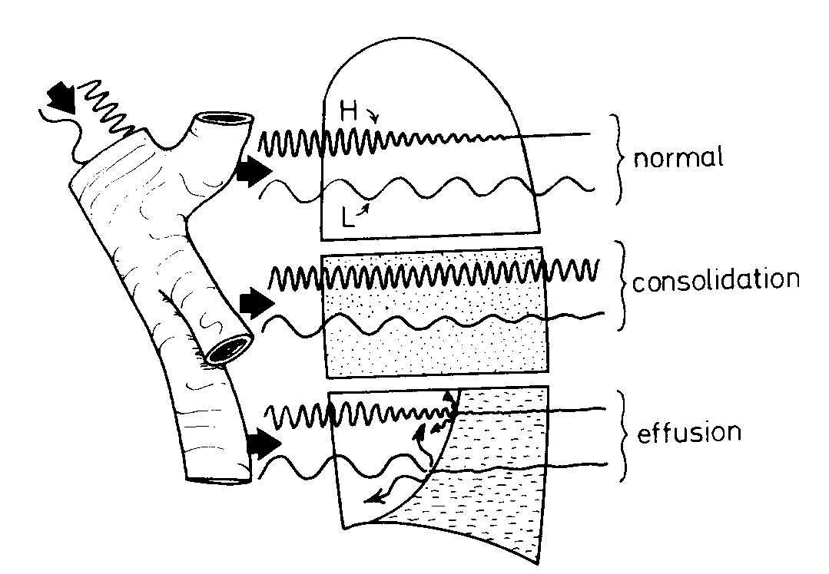
Vocal fremitus
pneumothorax

Slide 78
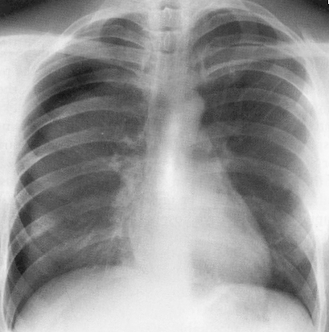

Slide 79
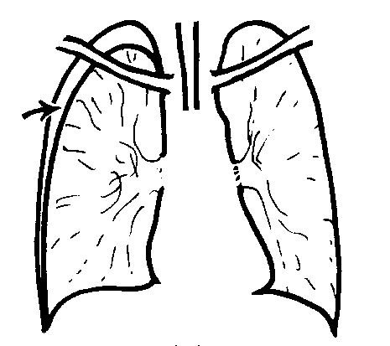
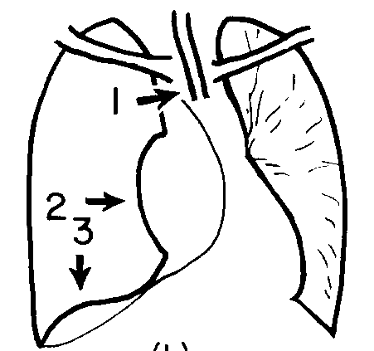

Slide 80
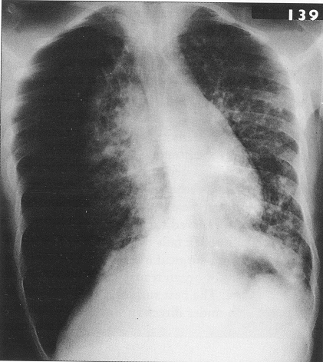

Slide 81
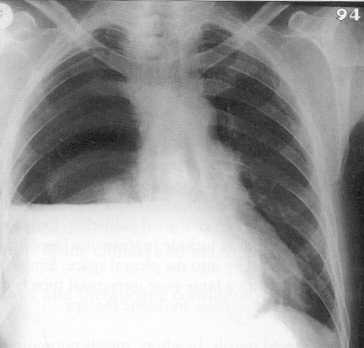

Slide 82
size
% pneumothorax = [1- (d³/D³)]x 100
D= diameter of the hemithorax
d = diameter of the lung = D – a
a = distance chestwall-lung

Slide 83
D= 10 cm
8³/10³ = 0.51
PNO= 49%
a = 2 cm

Slide 84
treatment
Watchfull waiting if primary PNO AND <20%
Oxygen
Single aspiration
Thorax drainage
Valve
Closed bottles
Pleurectomy
Pleurodesis

Slide 85
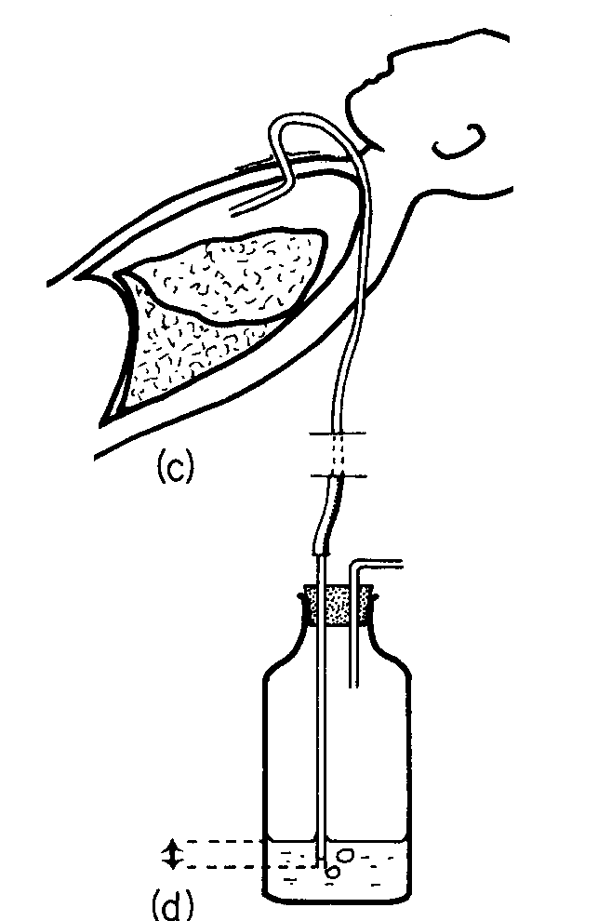

Slide 86
Recurrence rate
Spontaneous idiopatic PNO
After episode 1 40%
After 2 60%
After 3 80%
Higher in cases of secondary PNO

Slide 87
surgery
Thoracoscopy
Pleurectomy
Bullectomy
Pleurodesis
> 95% effective in preventing recurrences
Indications
Tension PNO
Mandatory in some professions/sports
Airline pilots
Deep sea divers/ professional divers
Mountaineers
….

Slide 88
pleurodesis
Glueing both pleural surfaces
Sclerosing agent
Tetracycline
Talc
Painfull +++ and fever
Through a thoracic drain or via thoracoscopy
Indications
Contraindication for thoracoscopic pleurectomy
Secundary PNO

Slide 89
Management of spontaneous idiopathic PNO
1°ste episode >20%: drainage
2° episode: drainage or pleurectomy or pleurodesis
3° episode: pleurectomy or pleurodesis

Slide 90
Management of secondary PNO
Consider
Comorbidity
Severity of symptoms
Size of PNO
Expertise and availability
Drainage
Pleurodesis
Surgery

Slide 91
Conclusion
Pneumothorax
Is a frequent mostly benign and well to treat affection of youth.
can be a source of severe morbidity and even mortality in the elderly pt with COPD/ emphysema(presence of air in the interstices of the connective tissue of a part.)

Slide 92
Pleural effusion

Slide 93
Pleural fluid
Normally 5-20 ml, < 2 g/dl protein, mesothelial cells shed from pleura
Production 100 ml/h
Resorption up to 300ml/h
Fluid via visceral pleura
Cells, protein via stomata in parietal pleura

Slide 94
transudate
Cardiogenic
Left ventricular failure, eg mitral valve, ischaemia
Hypoproteinemia
Hepatic
cirrhosis
Nephrogenic
glomerulonephritis

Slide 95
exsudate
Decreased clearing
Obstruction of Stomata
Fluid still resorbed
Increase in protein content
Local production of cells, protein, LDH, …

Slide 96
exsudate: Light’s criteria
Ratio PF protein/ S protein > 0.5
Ratio PF LDH/ S LDH > 0.6
Absolute LDH value in PF > 2/3 ULN S LDH
In the absence of hemolysis

Slide 97
Causes of PF
X 1000

Slide 98
presentation
Compression lung
Pleural inflammation
pain
Decreased expansion of the hemithorax
Dullness
Decreased
Breathing sounds
Vocal fremitus
Pleural rub

Slide 99
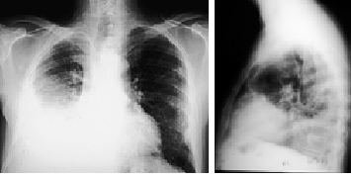

Slide 100
Pleural fluid
Meniscus sign
Obliteration of costphrenic angle
Tension hydrothorax
Thorax can contain up to 500 ml radiologically occult PF
in doubt ask for CXR in decubitus lateralis

Slide 101
investigations
Diagnostic thoracentecis (50-100 ml)
Chemistry
Cytology
Cultures
Pleural biopsy
Thoracoscopy

Slide 102
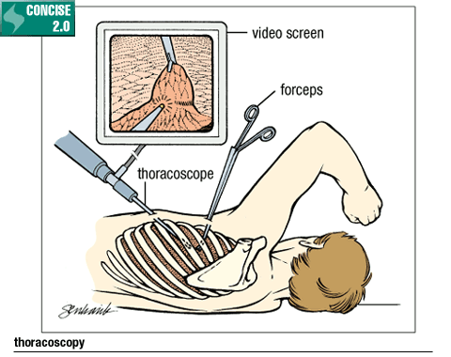

Slide 103
treatment
Causal
Transudate
Exsudate
Symptomatic
Evacuating thoracentesis (1-1,5 l/ 24h)
Drainage
Pleurodesis
Pleurectomy

Slide 104
Conclusion 2
Pleural fluid
Is a frequent finding in medicine
Cardiac factors most important reason for PF; mostly bilateral
If unilateral, to be investigated with thoracentesis
Any unexplained exsudate should be further explored
Treatment is causal whenever possible and symptomatic when needed

Slide 105
Special presentations
Chylothorax
Empyema
Hematothorax
Urinothorax
Malignant pleuritis
Mesothelioma

Slide 106
chylothorax
Chyl in the pleural cavity
Lesion of the ductus thoracicus
Tumor
Trauma
Surgically
Milky PF
Lymphocytes and triglycerides
Surgical?

Slide 107
empyema
Pyothorax
Pneumonia
pneumonectomy
Treatment
Drainage
Antibiotics
If pleural peel:
Decortication

Slide 108
hematothorax
Blood in the pleural cavity
Coagulates
Traumatic
Extern
Iatrogenic
Drug induced
Risk of infection
Drainage
Exploration

Slide 109
Malignant pleural effusion
Secundary/metastases
Lung cancer
Breast
Ovarian
other
Primary
Mesothelioma

Slide 110
pleurodesis
Via drainage or thoracoscopically
Sclerosis of pleural blades, no antitumor effect
Sterile talc best sclerosing agent
Either as slurry or as powder
Analgesia
Success in >90%

Slide 111


Slide 112
Sarcoidosis Pulmonary Management: Symptomatic Patients
Cough, dyspnea, and exercise intolerance may be symptoms of airflow obstruction
Consider treatment
Follow radiographs and PFTs
If no improvement, taper steroids to lowest effective dose and follow

Slide 113
COPD
Dr KWIZERA NDEKEZI Jackson
Anesthesiologist

Slide 114
Definition
Chronic airflow limitation
Usually progressive
Associated with abnormal inflammatory response of airways and lungs to noxious particles or gases
Exacerbation usually occur 1-3 times per year:
Increased shortness of breath
Increased purulent sputum secretions

Slide 115
Risk factors
Tobacco smoking
In door air pollution
Air pollution

Slide 116
Pathophysiology
Limitation to expiratory flow because of:
Narrowing of peripheral airways,
Mucus hypersecretion
Impaired ciliary function
Hyperinflation of the lungs

Slide 117
Pathophysiology…
Exaggerated chronic inflammation in the lungs in response to
Inhalation of cigarette smoke
This inflammation induces lung cell death
Imbalance between cell death and replacement
Destruction of alveolar septa witch causes emphysema
Changes of airway structure and lung parenchyma
This leads to symptoms of COPD

Slide 118
Pathophysiology…
Acute exacerbation of COPD:
Increased respiratory central drive with dyspnea, tachypnea, reduced TV
Hpercapnic respiratory failure
However V/Q match remains relatively normal
Decreased inspiratory capacity,
Decreased inspiratory muscle forces due to dynamic lungs hyperinflation
Increased serum inflammatory mediators: interleukin 6 (IL-6) and leucotrienne B4 (LTB4)

Slide 119
Pathophysiology…
Acute exacerbation of COPD:
Patient with severe airflow obstruction, there is increased work of breathing ( increased use of inspiratory muscles)
Abdominal muscles contraction
Worsening of gas exchange and ABG abnormalities are explained by:
Respiratory muscles fatigue,
Increased dead space by airway and lung hyperinflation
Alveolar hyperventilation

Slide 120
Pathophysiology…
Acute exacerbation of COPD:
Increased physiologic dead space witch impairs CO₂ elimination and leads to CO₂ retention and respiratory acidosis
Hypoxemia results from later alveolar hypoventilation and V/Q mismatch

Slide 121
Clinical manifestations
Patient with acute exacerbation of COPD:
Increasing cough, worsening dyspnea, increased purulent and viscous sputum secretion,
This can be triggered by respiratory tract infection
Patient appears in acute respiratory distress
Tachpnea, tachycardia and possible hypotension by auto PEEP (lung hyperinflation)
Use of respiratory accessory muscles

Slide 122
Clinical manifestations…
By inspiration, normally diaphragm moves down, forcing abdomen out,
With diaphragmatic fatigue, diaphragm rise (paradoxical breathing)
This is a sign of respiratory muscle fatigue,
Followed by ventilatory failure and respiratory arrest
Wheezing and other findings of airways obstruction
Cyanosis (hypoxemia)
Coma if severe acute CO₂ retention (Respiratory acidosis)

Slide 123
Factors precipitating acute COPD
Respiratory infections (bacterial or viral)
Cardiac arrhythmia
Pneumothorax
Pulmonary embolism
Pleural effusion
Medication failure/ lack of compliance to medications
Acute congestive heart failure
Coronary artery diseases

Slide 124
Management of COPD
Treat the underlying cause of acute exacerbation of COPD
Oxygen therapy, to maintain SPO₂ > 90% by increasing FiO₂
Nasal canula or ventouri masks can be used to initiate low FiO₂ that must be titrated to maintain SPO₂ at 88-92% or greater in acute severe hypoxemia and impending respiratory failure,
High flow oxygen therapy may be required.

Slide 125
Management of COPD …
Inhaled short-acting β2 agonists and antcholinergics
This combination prevents exacerbation, particularly the long acting agents
Risk of cardiac complications in elderly patient with CAD
However Salbutamol is well tolerated
IV methylxanthines (theophylline or aminophylline) are
Second line therapy, if no response to short acting bronchodilators

Slide 126
Management of COPD …
Corticosteroids
Systemic corticosteroids improve lung function
Predinsolone 30 mg/day for 14 days
Inhaled corticosteroids are associated with decreased acute exacerbations
ATBs:
In patient with dyspnea, increased purulent sputum secretion

Slide 127
Management of COPD …
Hemodynamic support:
IV fluids challenges in hemodynamic abnormalities
Inotropes:
Ex: Norepinephrine

Slide 128
Management of COPD …
The ARF in COPD is characterized by hypoxemia, hypercapnia and Respiratory acidosis
Non invasive mechanical ventilation by nasal or facial masks
This decreases the need of ETT
Indicated in pt:
Normal/ mild reduced pH without signs of respiratory failure
Ex: pH 7.25-7.35

